Slide 1
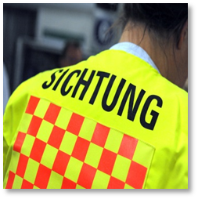
Munich Shootings – A Brief Summary
Sebastian Eberl

Slide 2
Sebastian EBERL
Research fellow at institute for emergency medicine and management in medicine (INM) Munich university hospital (KUM)
Deputy commissioner on disaster management for the university hospital
Paramedic and incident leader
Master of Arts in General & Healthcare Management

Slide 3
Chronology of events on July 22nd 2016

Slide 4
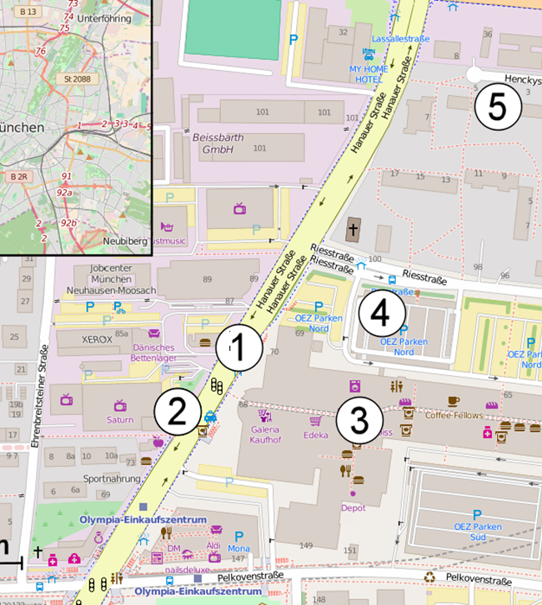
Chronology of events
17:50: beginning of shooting
17:52: first reports about use of firearms at OEZ shopping mall
Parallel activation of a fire alarm in fast food restaurant
ca. 18:00: physician staffed ambulance (based at INM) arrives shortly after first ambulance of fire department on site of fast food restaurant:
8 people dead on scene, one died later at the hospital:
Five at the fast-food restaurant
Two at the saturn-store
Two at the shoppingmall

Slide 5
Chronology of events
18:15: sighting of shooter in a nearby parking lot
18:30: the public is warned via various news channels
20:30: shooter commits suicide (gunshot to head)
Due to witness information officials deal with 3 suspects at the time → 60 assumed scenes
evacuation of Munich central station and shut down of public transport due to frequent “sightings of suspects” → numerous people hurt owing to panic reactions
at the time a large number of emergency helicopters (16), emergency physician vehicles, emergency paramedic ambulances are on call at three designated places over town

Slide 6
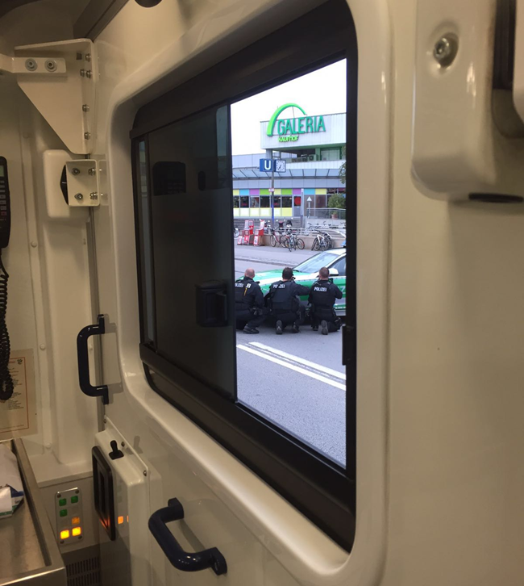
Chronology of events inside the hospital
18:11: alarm PVM level 3*, 25-50 critical and urgent patients
18:21: hospital-alarm level 3
alarming of off-duty personnel
parallel first delivery of patient at hospital inner city campus
18:30 establishing of operation control Großhadern and inner city with first briefing
19:30: establishing of hospital emergency task force
parallel resource build up (SR, ICU, OP, personnel, blood)
picture: operation site at OEZ shopping mall
Quelle: https://commons.wikimedia.org/w/index.php?curid=50423711

Slide 7
*Patient distribution matrix (PVM) Dispatch centre for Mass casualty incidents

Slide 8
Chronology of events inside hospital
at 21:30 the OR early morning staff was released from duty
creation of overnight accommodation inside the hospital
at the time no communication with defence control possible
22:30: no arrival of patients since 18:30 → slow demobilization
23:30: start of final demobilization
01:30: end of operation

Slide 9
Alarm evaluation GH

Slide 10
Alarm evaluation INN

Slide 11
Chronology of events- summary
Total of circa 30 Patients directly linked to the event
Over 2500 police officers responded
Over 300 EMS and Firecrews were involved
treated patients at KUM: 6, thereof 5 in critical condition
additional personnel used: ca. 500
capacities KUM from 7.00 pm:
13 ERs
5 CT
almost 20 OP`s
500 blood units 0-negative
over 20 ICU beds (ventilator-linked)

Slide 12
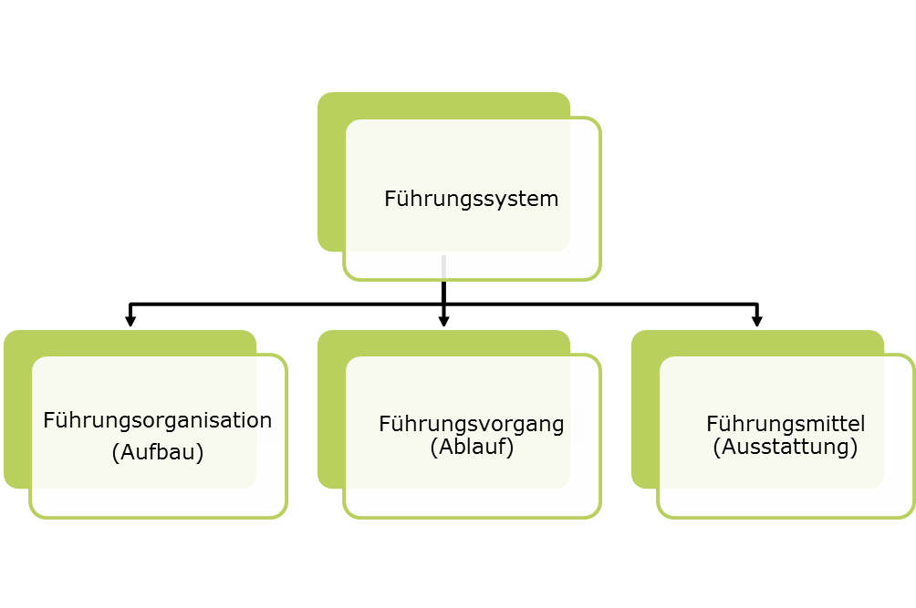
Organisation of disaster emergency care at KUM

Slide 13
Structural organization - responsibilities
head of disaster planning:
Commissioner of disaster management, Institute for Emergency Medicine and Medical Management (INM) at the University Hospital of Munich (KUM)
professional cooperation:
medical and nursing personnel of both Campuses as well as people in charge at maintenance, logistics, commerce provisioning etc.
duties:
creation and maintenance of alarm- and operation plans as well as accompanying guidelines, classes and support of crisis task force section
challenges:
two campuses with different structures, capacities and competences

Slide 14
Areas of disaster emergency care at KUM
clinical disaster management
Planning
Education
Drills
briefings
Seminars
Alarm- and operation planning:
drills
Division tutorials
Full tutorials
Internal and external incidents
E-Learning (incl. certificate) in progress
Operation
MCI
(Fire)
(Evacuation)
(clearance)
Special scenarios
Cooperation with security & fire commissioner
scenario-tutorials

Slide 15
Hierarchy: Structure & decision making
Klinikleitung
Stabstelle Katastrophenschutz
Ärztl. Personal
Pflege
Technik/Logistik
Information und Kommunikation
Weitere nach Bedarf
Anästhesie
Chirurgie (Unfall, Viszeral, Neuro, etc.)
Radiologie
Intensiv
Anästhesie
OP
Intensiv
ZNA
Medizinprodukte
Gebäude
Reinigungsdienst
Materiallager
IT
Pressestelle
Telefonzentrale
Pforte, Empfang, Portier
AG AEP
Notes:
Die AG wird durch die Vertreter der jeweiligen Fachbereiche ergänzt. Dies kann in einer ständigen Vertretung oder aber themenabhängig erfolgen

Slide 16
Besondere Aufbauorganisation Am Beispiel des Klinikums der Universität München (KUM) (Vereinfachte Darstellung)

Slide 17
Process organisation – Main Goals according to alarm and resource planNING
Establishing of designated leadership structures
Conversion of hospitals toward mass casualty incident management
Establishing of triage points
Check of quickly available resources (OP, ICU, IMC, CT, ER, blood, logistics)
Employee registration in personnel prep room
Dispatch of Neuro-, Visceral-, Thorax- und vascular surgery to inner city Campus if needed (outside standardized working hours)
Initializing of material orders
Re-establish daily business again after an event

Slide 18
Lessons LEarned

Slide 19
findings (selection)
positive:
Large personnel resources available within short notice (500 additional employees available on both campuses)
Structured and quiet processes despite information deficit
Concerted demobilization in order to have routine processes the following day
Opportunity to evaluate alarm and resource planning in a real life situation

Slide 20
findings (selection)
Negative
at no given time did the hospital receive information to the preclinical status quo
no contact with hazard control possible
Too much additional staff (more than needed for situation at hand)
Security situation (especially at inner city campus and Dr. von Haunersches children's hospital) not appropriate
Food supply not appropriate
Communication due to technical infrastructure only of limited use

Slide 21
The role of social Media Platforms 22.07.2016 for das KUM
Sighting of regular Social Media Platforms by the emergency task force
Information not reliable or relevant for further process; but: good overview about conditions on site
Social Networks led to panic reactions and opened up more than 60 events linked to the main shooting at OEZ (sightings of armed people, shots fired, people down etc.)
Critical evaluation of unofficial WhatsApp-groups in between campuses → false information regarding probable transport of ICU patients with gunshot wounds from inner city campus to Großhadern

Slide 22
Priorisierungsmatrix after 22nd of july

Slide 23
conclusion
University hospital Munich is prepared for an MCI quite well
More training at every organizational level
Revision of the alarm and resource plan needed
Contact to the pre-hospital organizations was established in order to discuss interface problems and to initiate better communication
The emergency care consortium of the Munich hospitals under the leadership of INM is actively looking for solutions to operationalize networking of the hospital emergency task forces.
The aim is to be able to give support to each other on short notice when needed

Slide 24
Thank you for your attention
Ansprechpartner:
Sebastian Eberl M.A.
Stellvertretender Katastrophenschutzbeauftragter
Klinikum der Universität München,
Institut für Notfallmedizin und Medizinmanagement
Telefon: 089 / 4400-57101
E-Mail: Katschutz.KUM@med.uni-muenchen.de
Internet: www.klinikum.uni-muenchen.de

