Slide 1
Night Operations in HEMS
S. Neppl
Dr. med. U. Aschenbrenner
Dr. med. M. Zimmermann

Slide 2
Night Operations in HEMS
INTRO
Personal details
Stefan Neppl, MBA
Department of Medicine Quality and Capacity development
HEMS-TC 24h-Base Regensburg
S. Neppl, Dr. U. Aschenbrenner, Dr. M. Zimmermann Munich, 08.11.2016

Slide 3
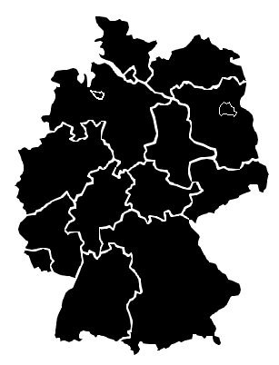
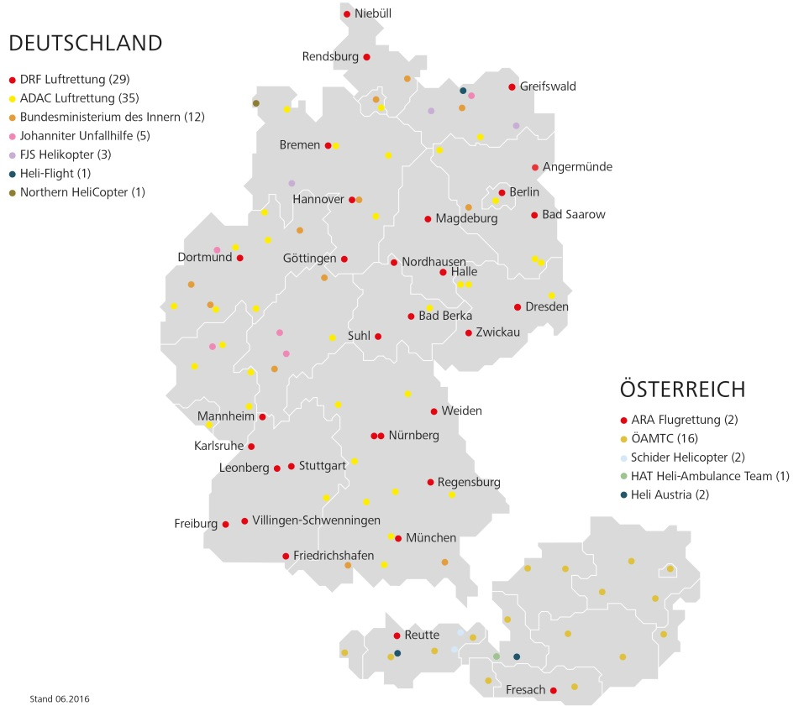
Night Operations in HEMS
INTRO
S. Neppl, Dr. U. Aschenbrenner, Dr. M. Zimmermann Munich, 08.11.2016
Notes:
The Federal Republic of Germany has a generally proven, nationwide and efficient air rescue system to carry out its public service tasks. However, as a result of the legal framework for civil air rescue, which has been valid until 2008, as well as the lack of a transnational cross-border coordination of the air rescue system, it has not yet been possible to integrate air rescue at night times into the rescue system of all regions of Germany according to the medical and economic necessities. In several scientific reports, air rescue at day time is seen as a key element of the primary patient transport within an evidence-based time grid into a suitable hospital. All the more paradoxical seems to be the fact that this resource of air rescue is insufficiently or not used at all during night time in some federal states.

Slide 4
Night Operations in HEMS
Legal regulations
Night Definition
Half an hour after sunset
Half an hour before sunrise
Flight times within >50% within this time
S. Neppl, Dr. U. Aschenbrenner, Dr. M. Zimmermann Munic, 08.11.2016
Notes:
According to the German Air Traffic Regulation (LuftVO § 2), the night is defined as the period between half an hour after sunset and half an hour before sunrise. After this German definition has been valid in 2014, and should be applicable also in the future, night flights are those with flight times (independent of the operating time) predominantly (> 50%) within this time period.

Slide 5
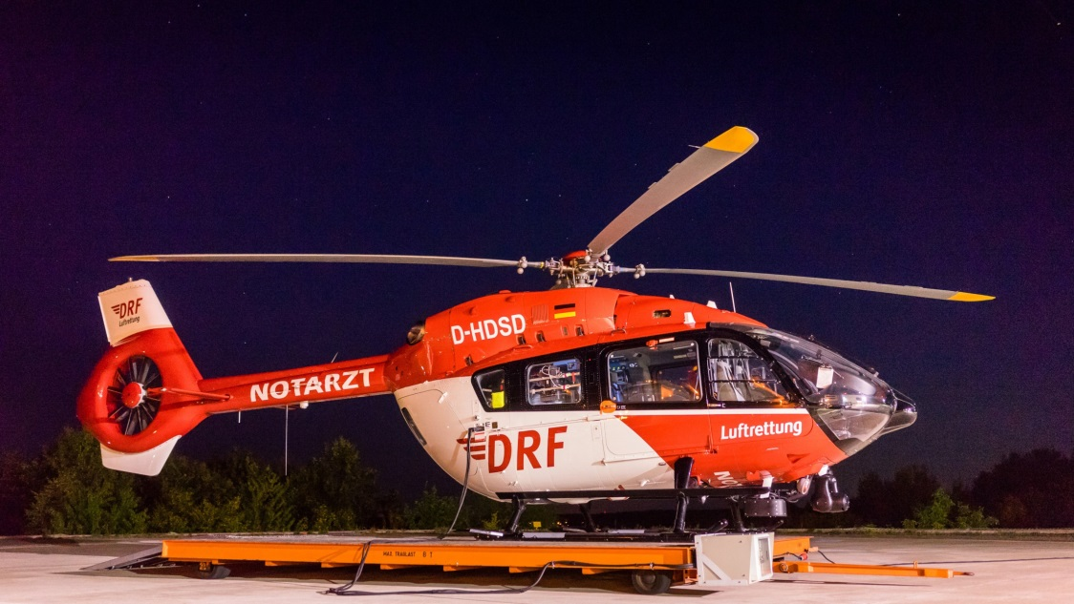
Night Operations in HEMS
Einsatzkonzept DRF Luftrettung
Additional Equipment
Search and landing light
Autopilot System
Weather Radar
Overregional 2 Pilots
Day 3-man-crew
Night 4-man-crew
S. Neppl, Dr. U. Aschenbrenner, Dr. M. Zimmermann Munic, 08.11.2016
Notes:
Since air rescue at night is mainly used overregional, 2 pilots are needed according to legal regulations. Thus, at night time another pilot is added to the usual 3-man crew (emergency physician, paramedic, pilot) during daytime. Due to its equipment and technical possibilities, the air rescue is aeronautically as well as medically able to perform complex rescue missions at night time. Thus, helicopters used in night flights usually have the following additional equipment: Search and landing light Autopilot system Weather radar.

Slide 6
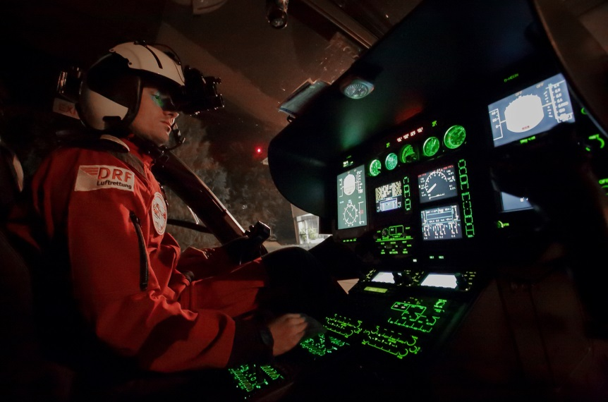
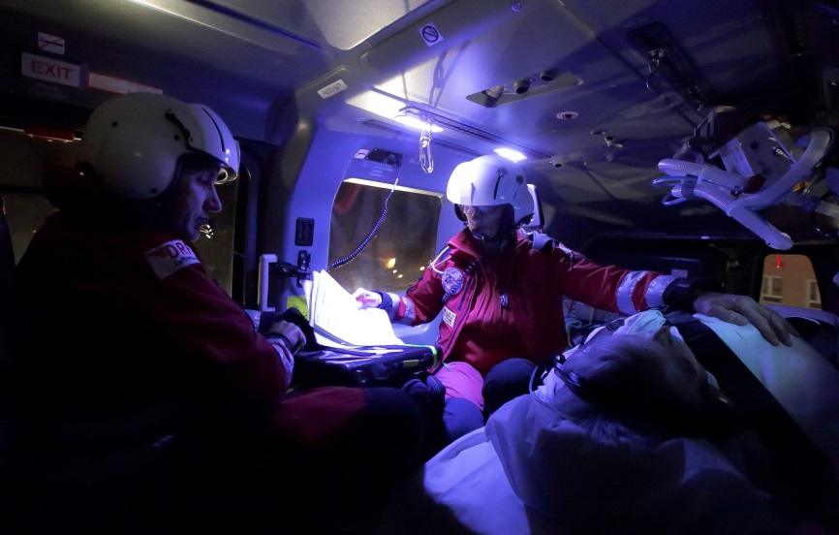
Night Operations in HEMS
Einsatzkonzept DRF Luftrettung
Operation of eight 24-hour stations in Germany
Equipped with special cockpit and cabin lighting
S. Neppl, Dr. U. Aschenbrenner, Dr. M. Zimmermann Munic, 08.11.2016
Notes:
Among other things, the medical equipment is mandatory according to EN 13718. For example, DIN EN 13718-2: 2008 contains operational and technical requirements for patient care. The requirements for medical devices (respiratory devices, ECG / defibrillator, number of syringe pumps, medical gas supply, etc.) and the medical consumables are completed by the persons performing the air rescue. The lighting of the interior cabine is also defined by EN 13718 to a minimum and can be expanded by special lighting technology according to the legal requirements by the air carrier companies. The application-oriented lighting situation must be adjustable by the aviation and medical crew for the individual needs independently of each other and without mutual interference. The illumination of the respective medical devices must allow their operation and must not impair optical alarm signals. An individual and situation-dependent adaptation of the light conditions for the outdoor area of ​​the helicopter, such as for loading and unloading procedures, must be possible.

Slide 7
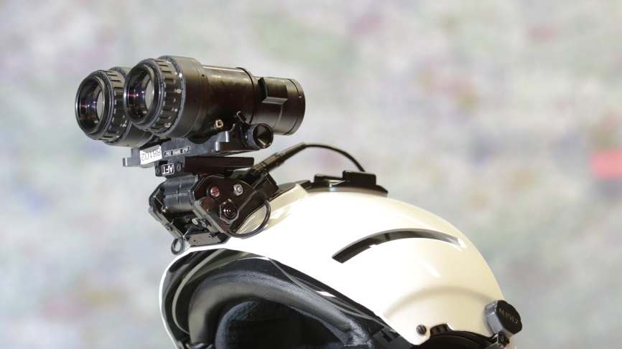
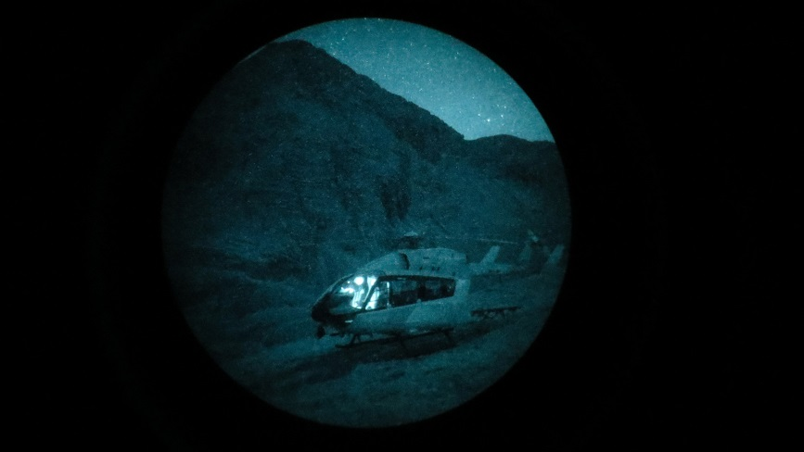
Night Operations in HEMS
Legal regulations - Night Flight
Forerunner in night flight (first non-military operator with NVGs) since July 2009
Application of night-view goggles (NVGs) that enormously enhance residual light.
The most night flight experience across Europe (2,132 deployments in 2015)
Application of next generation NVGs
S. Neppl, Dr. U. Aschenbrenner, Dr. M. Zimmermann Munic, 08.11.2016
Notes:
In terms of air traffic regulations, the European Aviation Safety Agency (EASA) forms the center of aviation policy in Europe. Under certain conditions the use of air rescue resouces is possible during night time. In 2008, the use of night vision goggles for civil air rescue was authorized by the German Federal Aviation Authority. This approval made a fundamental increase in flight safety possible. In addition, the use of "night vision googles" (NVG) significantly increased the operational spectrum during night time.

Slide 8
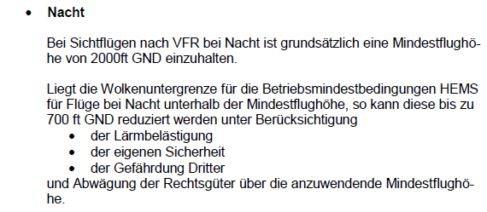
Night Operations in HEMS
Legal regulations
2 PILOTEN |  |  |  | 1 PILOT
TAG
Hauptwolkenuntergrenze | Sicht |  |  | Hauptwolkenuntergrenze | Sicht
500 ft und darüber | (siehe JAR- OPS 3.465) |  |  | 500 ft und darüber | (siehe JAR- OPS 3.465)
499-400 ft | 1000 m (Anmerkung 1) |  |  | 499-400 ft | 2000 m
399-300 ft | 2000 m |  |  | 399-300ft | 3000 m
NACHT
Wolkenuntergrenze |  | Sicht | Wolkenuntergrenze |  |  | Sicht
1200 ft (Anmerkung 2) |  | 2500 m | 1200 ft (Anmerkung 2) |  |  | 3000 m
Anm. 1 und 2:
2 Piloten, Instrumentenflugberechtigung, Erfahrung im Nachtflug, ggf NVG
S. Neppl, Dr. U. Aschenbrenner, Dr. M. Zimmermann Munic, 08.11.2016
Notes:
The legal basis for transport in the air is made by the EASA and further defined in national regulations by the Member States. The availability of air rescue at night depends not only on the pilots´ licensing and the equipment of the helicopter, but also on weather conditions. The following weather criteria are valid for Helicopter Emergency Medical Services (HEMS) at night:

Slide 9
Night Operations in HEMS
Legal regulations
Weather criteria
Two pilots
Horizontal view of 2.500m
Cloud limit of at least 1200 feet
Reduced to 700 feet at short time
Pilots authorization to fly into clouds and perfom the flight according to instrument fligth rules
S. Neppl, Dr. U. Aschenbrenner, Dr. M. Zimmermann Munic, 08.11.2016
Notes:
The following weather criteria are valid for Helicopter Emergency Medical Services (HEMS) at night:
- For a flight with two pilots, a horizontal view of 2500m and a cloud limit of at least 1200 feet (approximately 350m), which can be reduced to 1000 feet (approximately 304m) at short notice, must be present. (EU Directive 965 // 2012 SPA.HEMS.120) - In case of provided instrument flight authorization, the pilot is authorized to fly into the clouds and to perform the flight according to instrument flight rules.

Slide 10
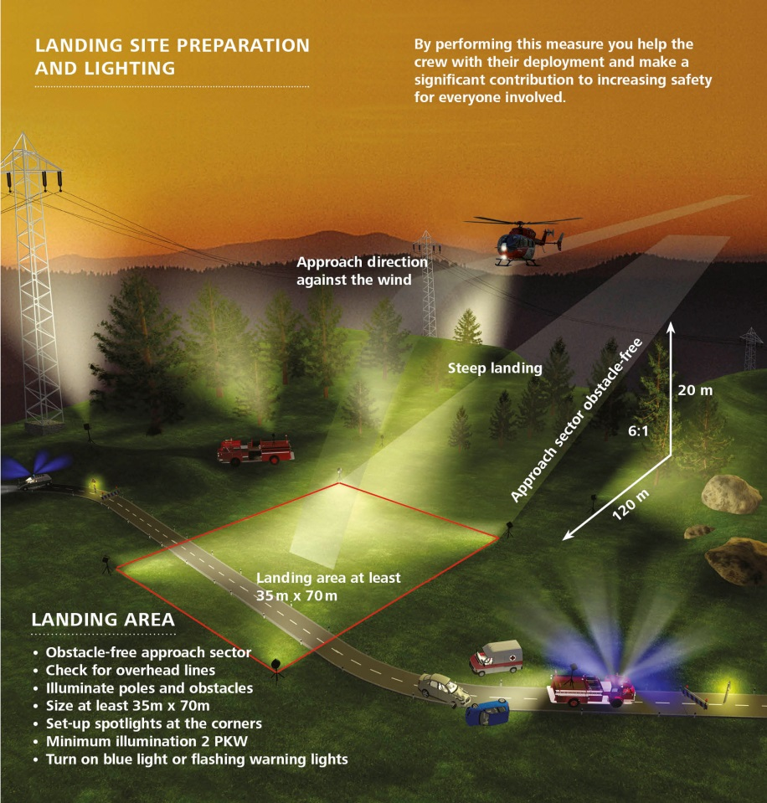
Night Operations in HEMS
Einsatzkonzept DRF Luftrettung
Landing only possible on secured, unobstructed and illuminated areas
S. Neppl, Dr. U. Aschenbrenner, Dr. M. Zimmermann Munic, 08.11.2016
Notes:
Among other things, the medical equipment is mandatory according to EN 13718. For example, DIN EN 13718-2: 2008 contains operational and technical requirements for patient care. The requirements for medical devices (respiratory devices, ECG / defibrillator, number of syringe pumps, medical gas supply, etc.) and the medical consumables are completed by the persons performing the air rescue. The lighting of the interior cabine is also defined by EN 13718 to a minimum and can be expanded by special lighting technology according to the legal requirements by the air carrier companies. The application-oriented lighting situation must be adjustable by the aviation and medical crew for the individual needs independently of each other and without mutual interference. The illumination of the respective medical devices must allow their operation and must not impair optical alarm signals. An individual and situation-dependent adaptation of the light conditions for the outdoor area of ​​the helicopter, such as for loading and unloading procedures, must be possible.

Slide 11
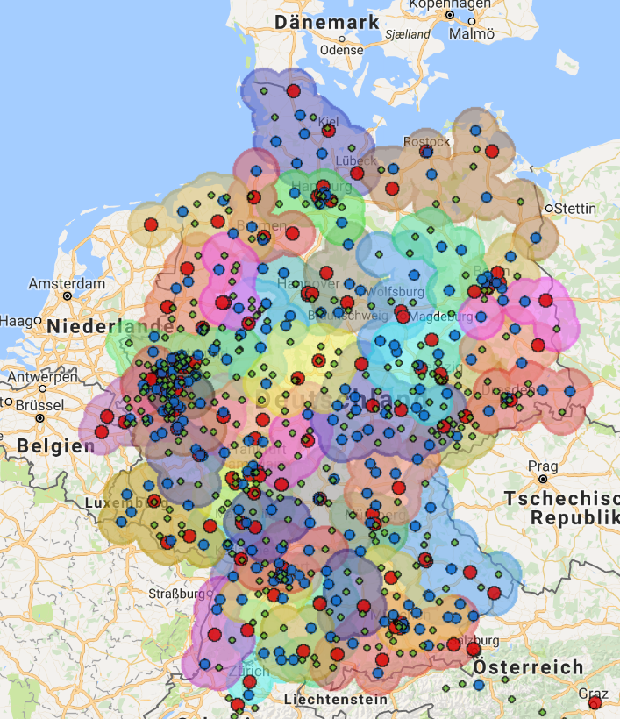
Night Operations in HEMS
Trauma network Sept. 2016
Quelle: http://map.telekooperation-tnw.de/
S. Neppl, Dr. U. Aschenbrenner, Dr. M. Zimmermann Munich, 08.11.2016
Notes:
Established hospital network structures and their allocation procedures therefore only display their full functionality during the provision of air rescue between sunrise and sunset, whereas in regions without provision of night air rescue the medical emergency care is essentially only maintained by the ground-based rescue services. From a medical point of view, it is hardly understandable that emergency medical care and compliance with care timing requirements should be achieved without the primary aid of air rescue, as during day times. Particularly in rural regions, the rare ground-based rescue services at night times represent a further reason to consider how complex ground-based emergencies with long patient care and transport times limit the emergency medical needs of the rural population.

Slide 12
Night Operations in HEMS
Methods
Data evaluation:
01.01.2014 – 31.12.2014
24.442 primary rescue missions during the day
693 primary rescue missions during the night
S. Neppl, Dr. U. Aschenbrenner, Dr. M. Zimmermann Munic, 08.11.2016
Notes:
All nationwide air rescue missions of the DRF in Germany were analysed and all primary and secondary rescue missions were evaluated that were carried out between 01.01.-31.12.2014. Aviation and operational tactics, and medical data were recorded by a documentation program called "MEDAT©" which was specially developed by DRF air rescue. A total of 25,164 primary missions in 2014 were evaluated. Ground-bound missions by the rescue transport helicopter (RTH) team as well as false alarm missions and canceled flights were excluded. 24,442 primary day missions and 693 primary night missions were included.

Slide 13
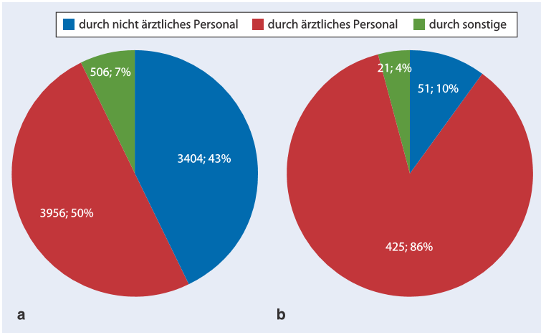
Night Operations in HEMS
Results
Analysis of alerting during day vs. night
S. Neppl, Dr. U. Aschenbrenner, Dr. M. Zimmermann Munic, 08.11.2016
Notes:
Data analysis of the type of alarm during day time showed a post-alarming rate of 32% (n=7866). Post-alerting is performed by the emergency physician in 50% (n=3956), by the rescue service personnel 43% (n=3404) and in 7% of the cases by other emergency personnel. During night time, the post-alerting rate increases up to 78% (n=691) and is performed in 86% (n=425) of the cases by the emergency physician.

Slide 14
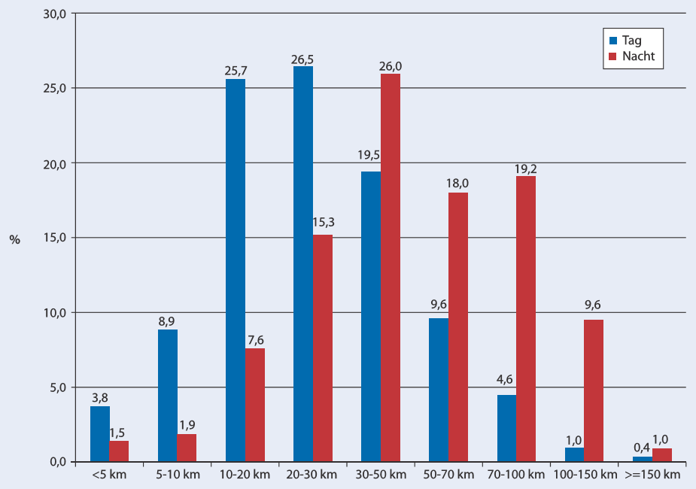
Night Operations in HEMS
Results
Analysis of radius and time day vs. night
S. Neppl, Dr. U. Aschenbrenner, Dr. M. Zimmermann Munic, 08.11.2016
Notes:
Analysis of the average radius for primary missions reveals a significant increase during night time. The air rescue device of the 24-hour stations is used in a 10- to 60-kilometer radius around the station during day time. The radius of use increases up to a distance of 50-100 km during night time.
The time from the alerting to the release of the air rescue device for primary missions during day time is on average 2:24 min at all stations of the DRF air rescue. During night time, this average time is up to 06:27 min. In addition, the flight time during night time is increased up to 19:33 min in contrast to 10:01 min during daytime. The pre-hospitalization time of air rescue is defined as the time between alerting of the rescue helicopter and the transfer of the patient at the target clinic. It is 50:09min during the day and 01:11:14 h during the night.

Slide 15
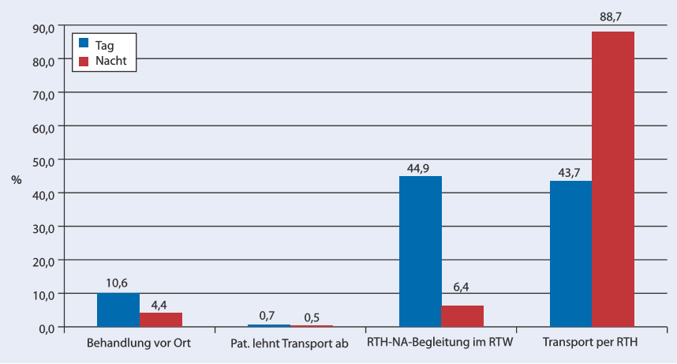
Night Operations in HEMS
Results
Analysis of time day vs. night
S. Neppl, Dr. U. Aschenbrenner, Dr. M. Zimmermann Munic, 08.11.2016
Notes:
Approximately 90% of all rescue helicopter missions are accompanied by a rescue helicopter emergency physician (day 88.6%, night 95.1%). During the night 88.7% (n = 583) of all patients are transported airborne (6.4% n=42 ground-bound) to the target hospital while during the day only 43.7% (n = 8.180) are transported by helicopter (44.9 % n=8,406 ground bound). During the day 10.6% (n=1989) of all primary missions and during the night in 4.4% (n = 29) a treatment on site is performed.

Slide 16
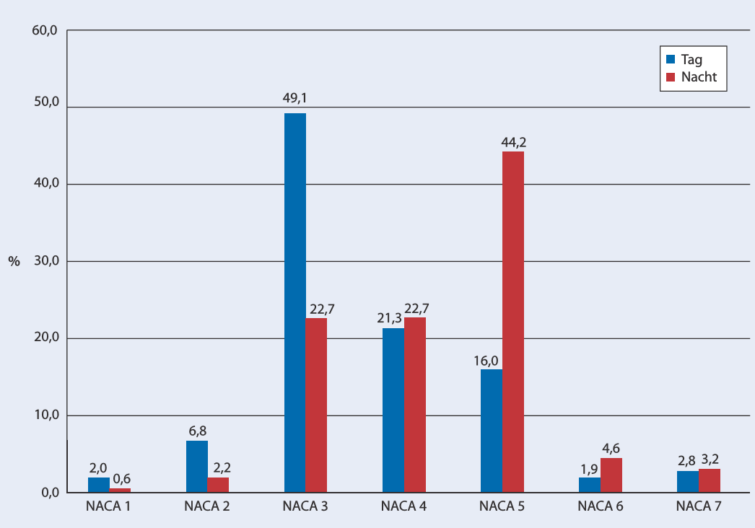
Night Operations in HEMS
Results
NACA day vs. night
S. Neppl, Dr. U. Aschenbrenner, Dr. M. Zimmermann Munic, 08.11.2016
Notes:
The analysis of the NACA score (National Advisory Committee for Aeronautics) also confirms the assumption of the different indications of air rescue at night compared to the day. While the patients showed 6.8% NACA 2, 49.1% NACA 3; 21.3% NACA 4 and 16% NACA 5 during the day, patients during the night show a significantly higher NACA: 22.7% NACA 3; 22.7% NACA 4 and 44.2% NACA 5. 4,6% of the patients had a NACA 6.

Slide 17
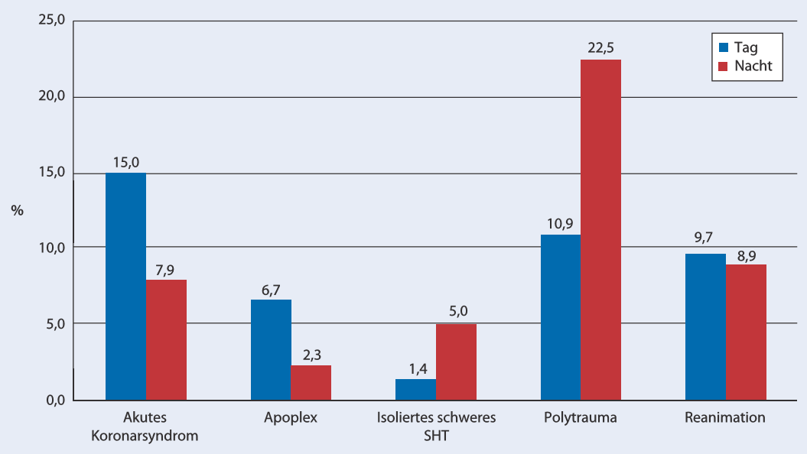
Night Operations in HEMS
Results
Tracer diagnoses day vs. night
S. Neppl, Dr. U. Aschenbrenner, Dr. M. Zimmermann Munic, 08.11.2016
Notes:
The analysis of the tracer diagnoses shows a significantly higher number of incidences for acute coronary syndrome as well as for the apoplex during the day. On the other hand, the number of polytraumatized patients doubled from 10.9% to 22.5% during the night hours. The percentage of patients with isolated severe cerebral brain trauma also increases from 1.4% to 5% during the night.

Slide 18
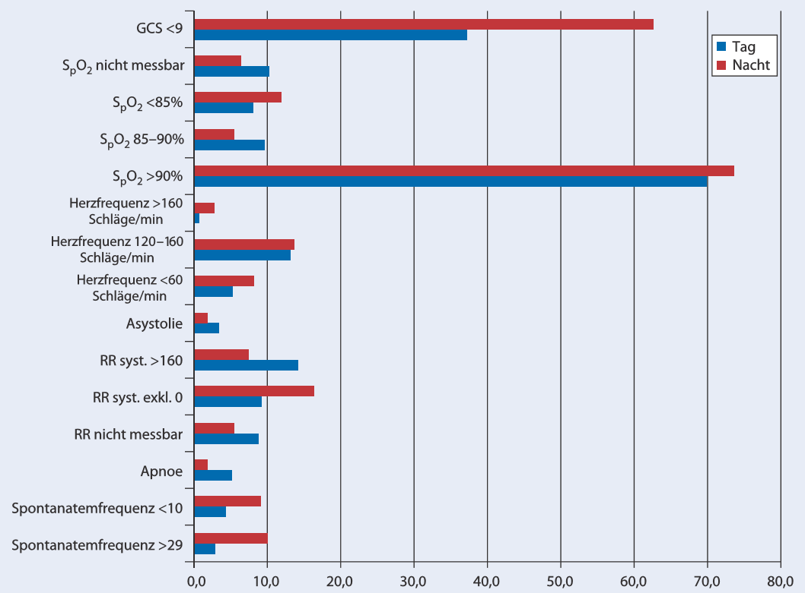
Night Operations in HEMS
Results
Clinical status day vs. night
S. Neppl, Dr. U. Aschenbrenner, Dr. M. Zimmermann Munic, 08.11.2016
Notes:
The figure shows an overview of the preclinical status of the patients at the time of arrival of the rescue helicopter emergency physician, regardless of the on-site emergency forces. Only patients with an age ≥14 years were analyzed. The higher NACA score during the night, which has already been described previously, was also confirmed by the clinically more critical status of the patients at the arrival of the rescue helicopter emergency physician arrives, which illustrates the more frequent indication for targeted post-alerting of the air rescue.

Slide 19
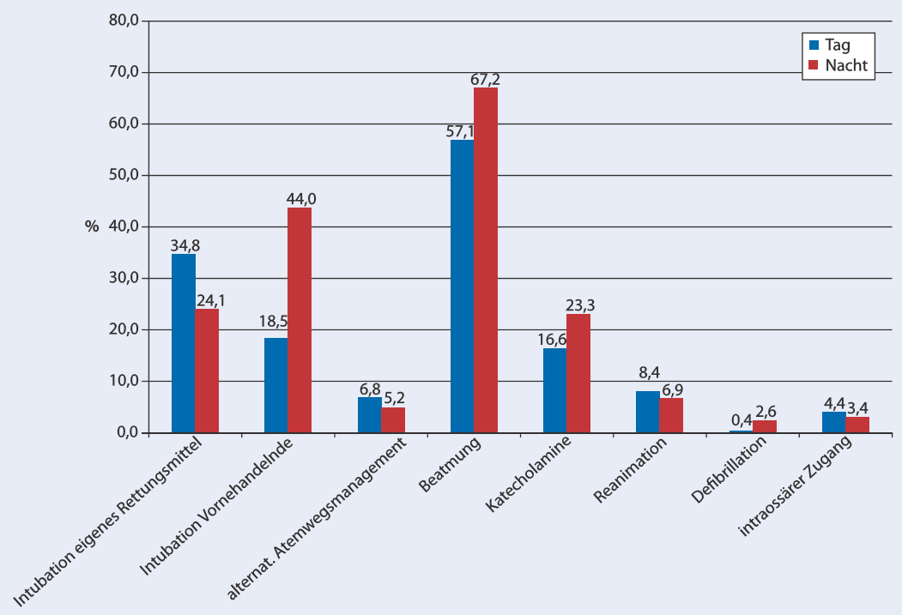
Night Operations in HEMS
Results
Therapeutic measures for polytrauma day vs. night
S. Neppl, Dr. U. Aschenbrenner, Dr. M. Zimmermann Munic, 08.11.2016
Notes:
The high percentage of post-alertings of the air rescue during the night is reflected by the supply of polytraumatized patients. This analysis shows a comparison of performed medical therapeutic measures in polytraumatized patients between day and night. Essentially, an increase percentage of nightly intubations by the ground-based emergency physician can be observed. The frequent post-alerting acts as a filter for the patients requiring polytraumatization. 68.1% (n = 79) of all polytraumatized patients have an indication for preclinical intubation during the night hours and 53.3% during the day.

Slide 20
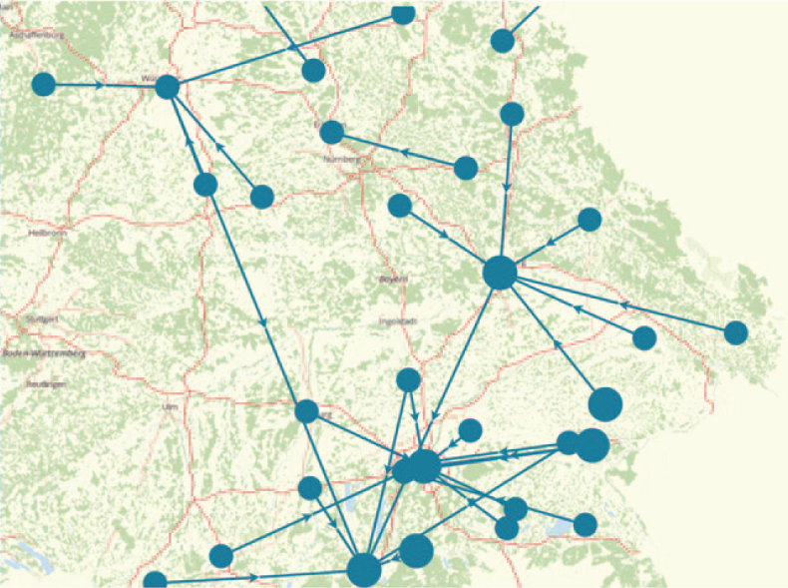
Night Operations in HEMS
Results
Secondary transport during the night
S. Neppl, Dr. U. Aschenbrenner, Dr. M. Zimmermann Munic, 08.11.2016
Notes:
The operative tactical features of air rescue for the secondary patient care are the fast provision and also the fast transport of the patient inside as well as outside of a clinical network under the maintenance of the medical care. The cartographic demonstration of the performed secondary transports of polytraumatized patients of one year using the example of the Freistaats Bayern shows the centripetal patient delivery to clinics with a higher supply level. Air rescue has an elementary key role for the functionality and interaction of a clinical networks at day and night. A rapid transfer of patients to a higher care facility can be ensured while maintaining intensive medical care.

Slide 21
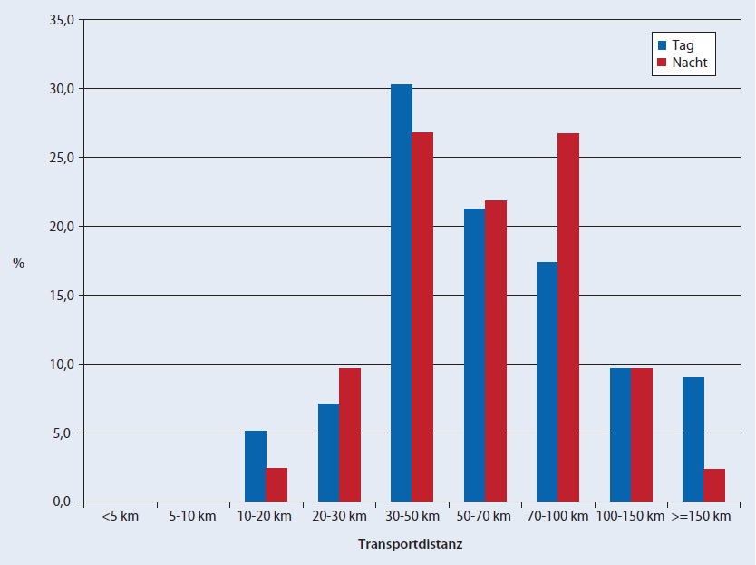
Night Operations in HEMS
Results
Secondary transport during the night
S. Neppl, Dr. U. Aschenbrenner, Dr. M. Zimmermann Munic, 08.11.2016
Notes:
The analysis of the flight distances from secondary transfers at nighttime showed a higher transport distance at nighttime compared to daytime. This avoids long-distance ground-bound transports and also further thinning of the emergency service, which is already limited at night hours.

Slide 22
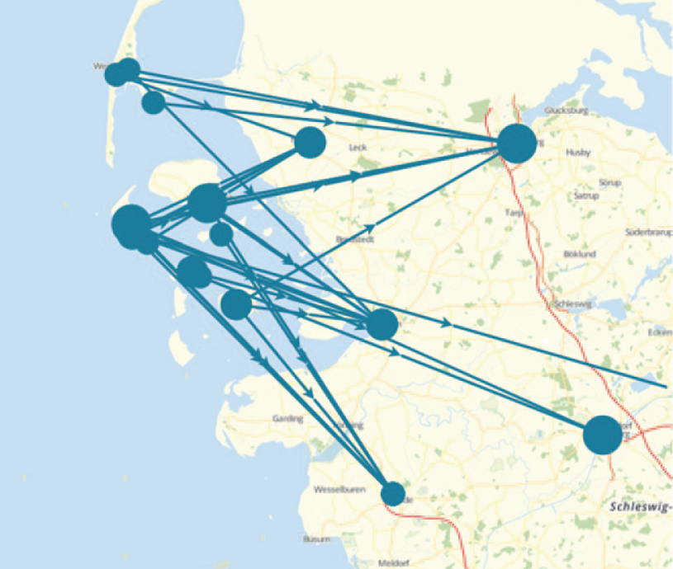
Night Operations in HEMS
Results
S. Neppl, Dr. U. Aschenbrenner, Dr. M. Zimmermann Munic, 08.11.2016
Notes:
Irrespective of the temporal advantages of air rescue, special geographic areas represent an indication of night-time air rescue. Sparsely populated regions, island or mountainous regions, which have a weak supply structure especially in the night hours, can be found in all federal states of Germany. The importance of air rescue in such areas was illustrated by the example of the North Sea islands. In addition to acute medical care, the focus lies on the fast transport through air rescue in geographically special regions.

Slide 23
Night Operations in HEMS
Summary
- System advantage of the high speed performance of the air rescue is an evidence- based lethality advantage of critically ill or injured patients,
- The reason for this is the transport into the most suitable hospital
S. Neppl, Dr. U. Aschenbrenner, Dr. M. Zimmermann Munic, 08.11.2016

Slide 24
Night Operations in HEMS
Summary
- air rescue during night represents a special challenge to the whole rescue team.
As during day, the poor visibility increases danger potential for the whole ground and airbound rescue team and for the patient.
- By coordinated, adjusted and trained nightly operations, the night air rescue does not significantly increase the risk compared to the day time rescue missions.
S. Neppl, Dr. U. Aschenbrenner, Dr. M. Zimmermann Munic, 08.11.2016

Slide 25
Night Operations in HEMS
Summary
By coordinated, adjusted and trained nightly operations, the night air rescue does not significantly increase the risk compared to the day time rescue missions. The use of night air rescue needs:
1.) Justified alerting of medical primary rescue mission
2.) At night 4-man helicopter crew
S. Neppl, Dr. U. Aschenbrenner, Dr. M. Zimmermann Munic, 08.11.2016

Slide 26
Night Operations in HEMS
Summary
3.) Pilots with instrument flying skills and experience in dealing with night vision equipment, use of suitable and approved aircrafts for night flights including cabin interior and appropriate medical technology, use of night vision equipment.
S. Neppl, Dr. U. Aschenbrenner, Dr. M. Zimmermann Munic, 08.11.2016

Slide 27
Night Operations in HEMS
Summary
4.) Comprehensive training of ground-based personnel including command centers, fire brigades, police, etc.
5.) Establishment and agreement on suitable landing sites during night, such as sports fields, hospital landing sites, etc., especially with regularly destinations
6.) Regional dependent determination of necessary logistics during the rescue mission fire brigade for lighting, shuttle vehicles etc. The strict determination of landing sites for primary operations at night has not proven successful.
S. Neppl, Dr. U. Aschenbrenner, Dr. M. Zimmermann Munic, 08.11.2016

Slide 28
Night Operations in HEMS
Summary
- currently, air rescue during the night cannot and does not want to replace a working ground-based rescue infrastructure
- the early indication of the correct rescue mission disposition is particularly important during the night
S. Neppl, Dr. U. Aschenbrenner, Dr. M. Zimmermann Munic, 08.11.2016

Slide 29
Thank you for your attention

