Slide 1
Quality measurement in physician-staffed EMS
Helge Haugland
PhD-student, Norwegian Air Ambulance Foundation
Anaesthesiologist, 330-squadron, Ørland, Norway

Slide 2
Quality in health care
Institute of Medicine. Emergency Medical Services at a Crossroads. The National Academies Press, Washington DC, USA2006.
NCQA’s The Essential Guide to Health Care Quality, available at: http://www.ncqa.org/tabid/460/Default.asp
World Health Organization. Quality of care: a process for making strategic choices in health systems. 2006.
M.E. Porter “What is value in Health Care?” N Engl J Med 2010, 363(26):2477-2481.

Slide 3
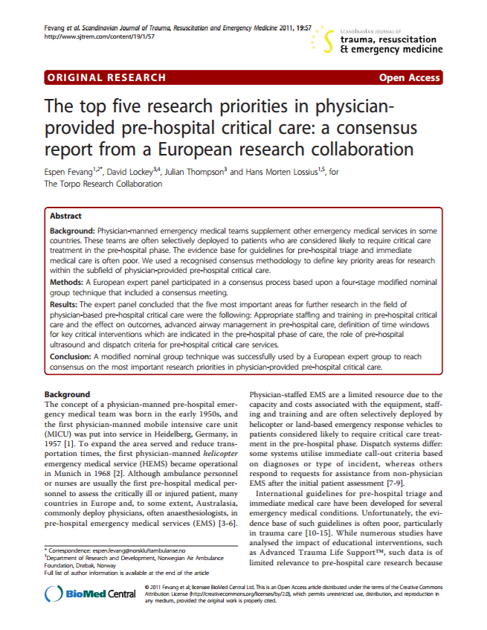
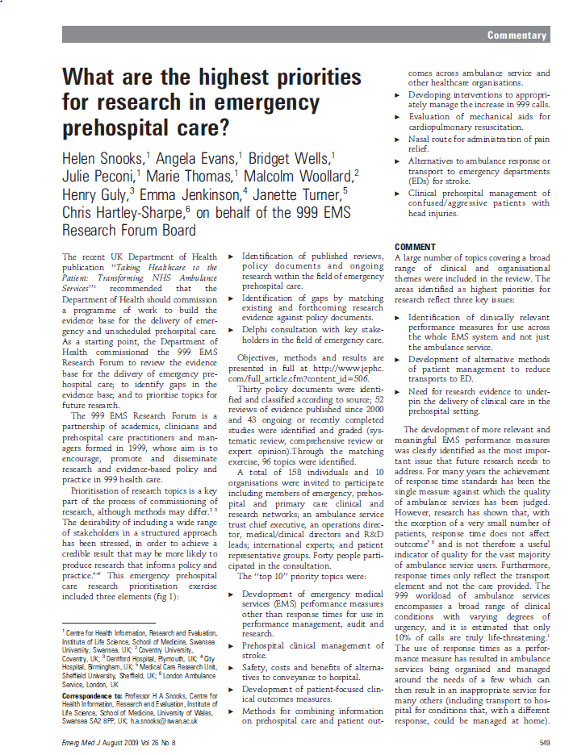
Quality in physician-staffed EMS

Slide 4
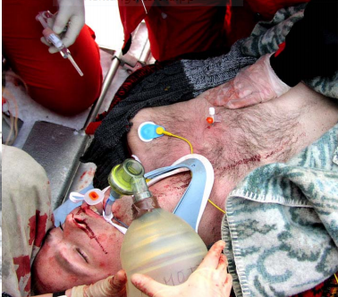
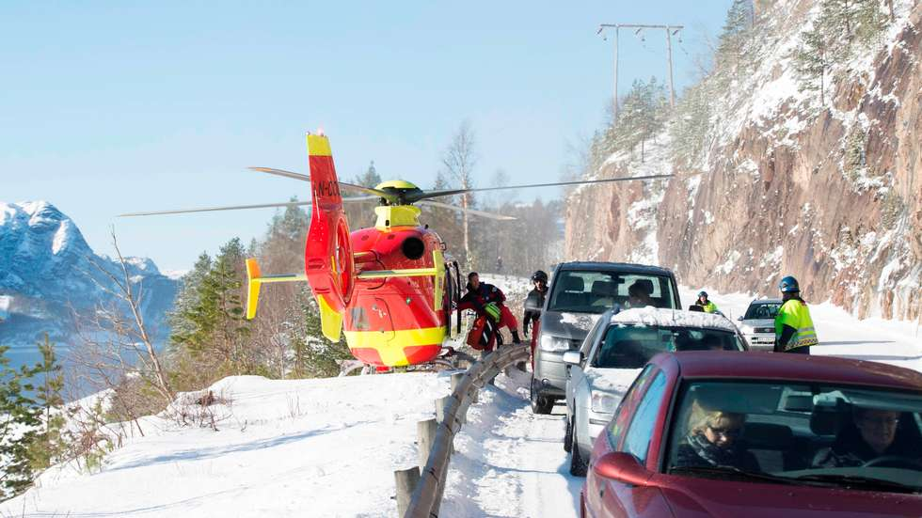
What is quality in physician-staffed EMS?

Slide 5
Quality for whom?

Slide 6
Maybe quality is more than time variables…?

Slide 7
Measuring quality of restaurants Quality indicator: Time from placing your order until dinner is served
Loser: 30 min
Winner: 2 min

Slide 8
How should we measure quality in physician-staffed EMS?
Patient-centeredness
Safety
Effectiveness
Efficiency
Equity
Timeliness
The six quality dimensions in health care
Institute of Medicine, 2001

Slide 9
How should we measure quality in physician-staffed EMS?
By using the correct «tools» for quality measurement.

Slide 10
“Far better an approximate answer to the right question, which is often vague, than an exact answer to the wrong question, which can always be made precise.”

Slide 11
Quality measurement: challenges
Hard clinical endpoints matters the most, but are not optimal quality indicators.
Quality indicators must reflect different quality in our work.
What a quality indicator measures, must occur with a certain frequency.
Quality measurement must be so simple that it can be included as a part of everyday registration.
Quality measurement must be so detailed that it can tell us something about the quality of the work.
The total quality can not be covered by one quality indicator alone.

Slide 12
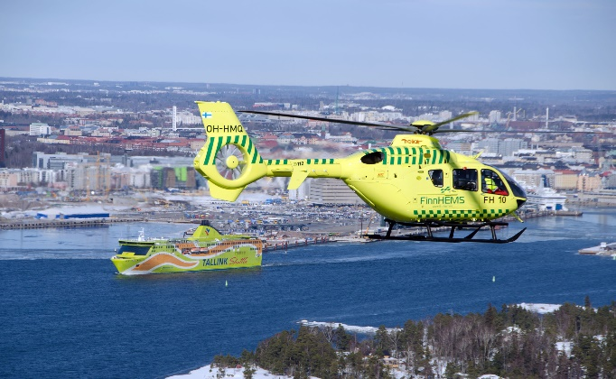
Who is in?
Finland:
Vantaa
Turku
Tampere
Oulu
Kuopio
Denmark:
Skive
Billund
Ringsted
Sweden:
Uppsala
Karlstad
Norway:
Trondheim
Stavanger
Arendal
Ørland
Lørenskog
Rygge

Slide 13
Measurement for
judgement
Measurement for improvement

Slide 14
Thanks for your attention.

